Slide 1
Data Science

Slide 2
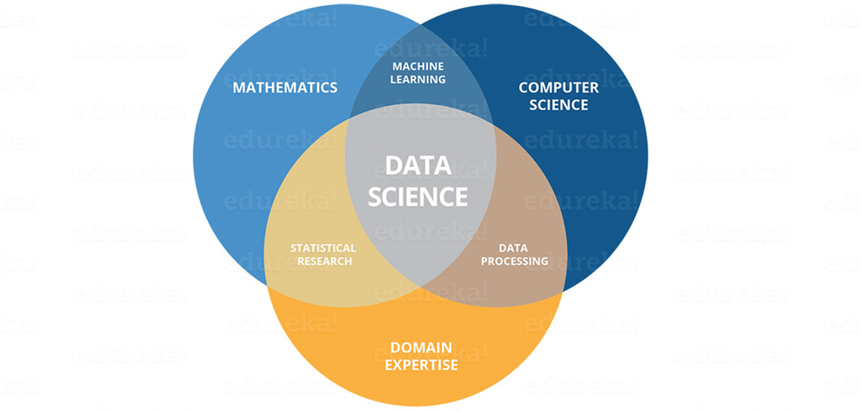
Data Science
Skill of extraction of knowledge from data (correlation)
Using knowledge to predict the unknown (loan ex.)
Improve business outcomes with the power of data

Slide 3
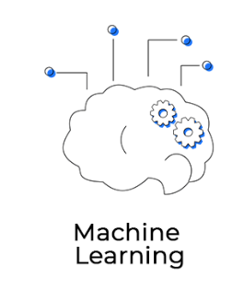
Machine Learning
Computers are beginning to learn from data without explicitly programmed

Slide 4
Types of Machine Learning
Supervised Learning (Regression , Classification)
Unsupervised Learning (Clustering, Association rule)

Slide 5
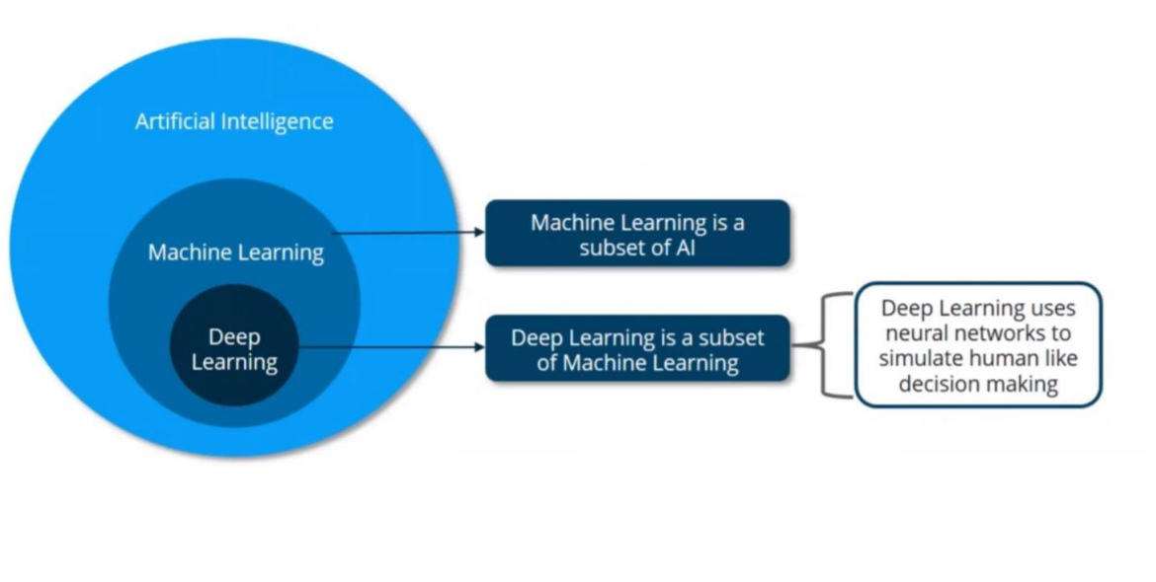

Slide 6
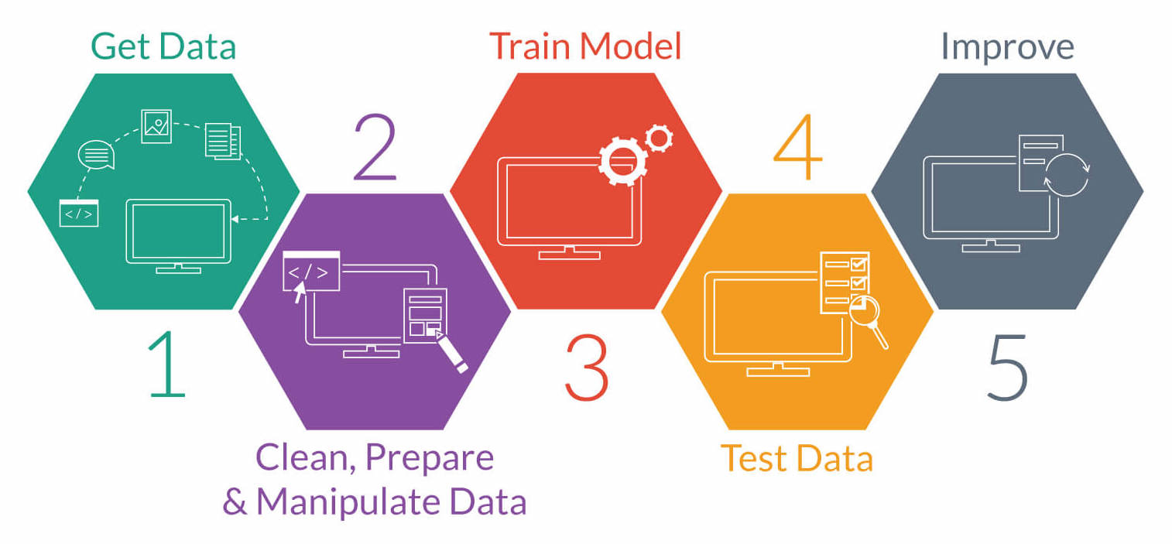

Slide 7
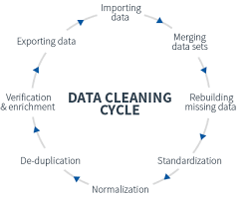
Feature extraction and cleaning of data

Slide 8
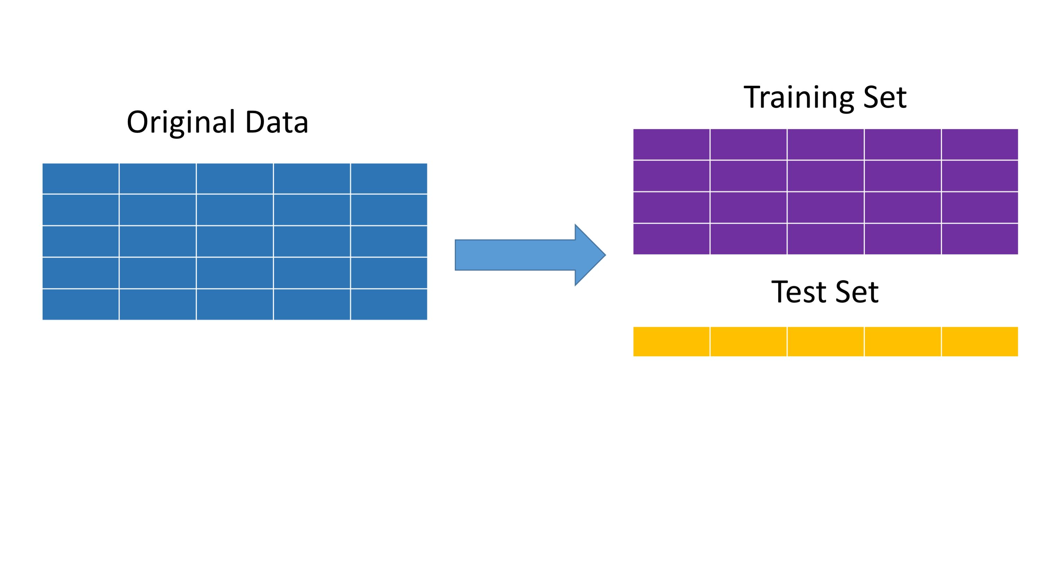
Train and test data

Slide 9
Models
Support Vector Machine
Decision Tree
Random Forest

Slide 10
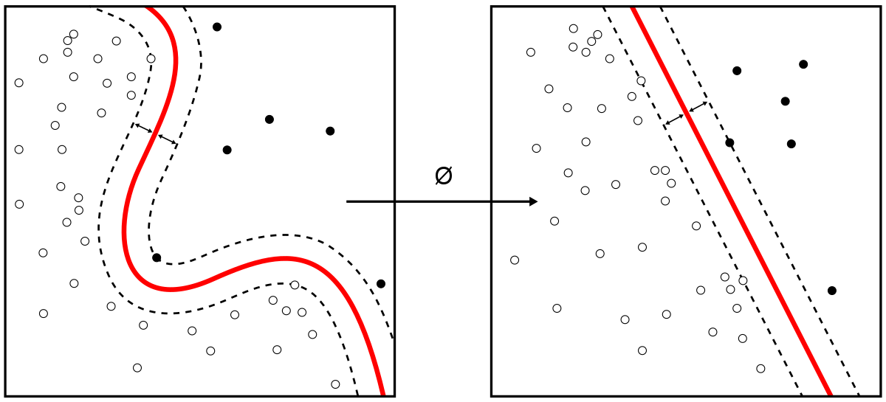
Support Vector Machine

Slide 11
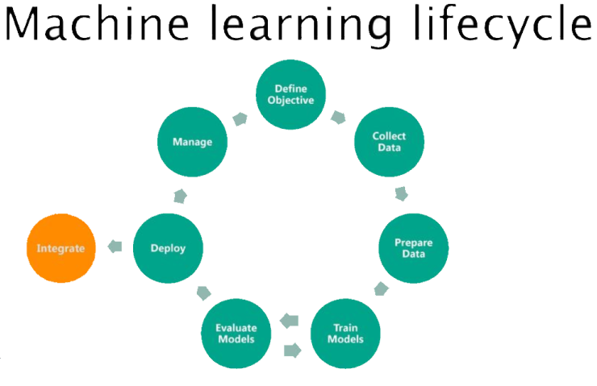

Slide 12
Thank You

